Slide 1
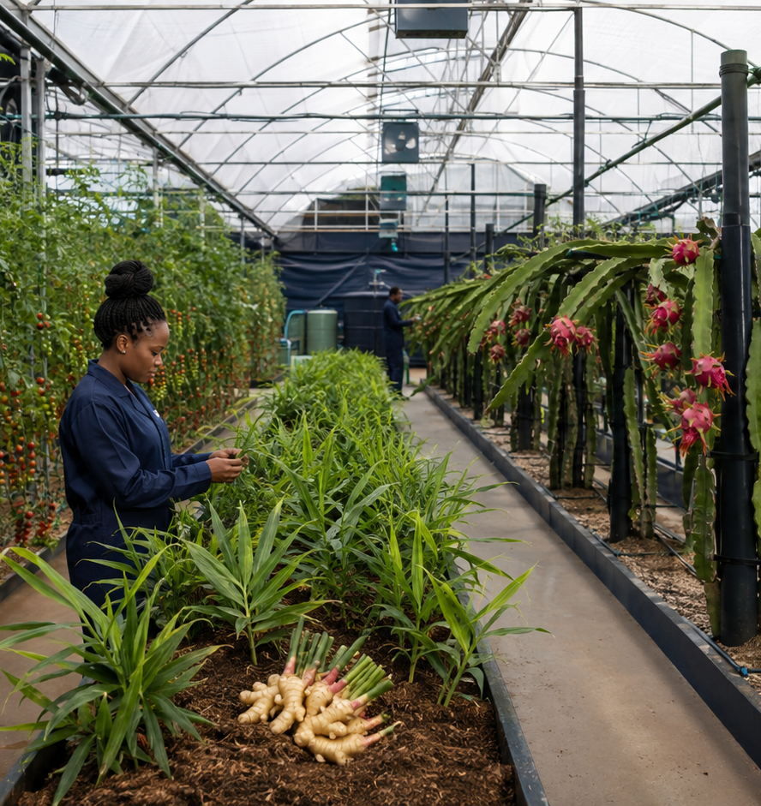
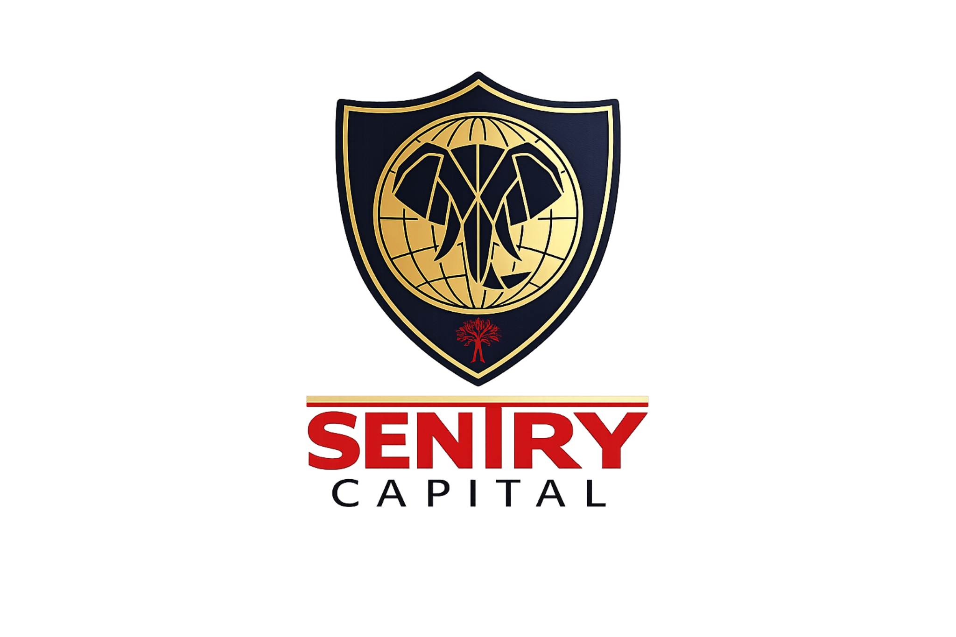
SENTRY CAPITAL PRODUCT PRESENTATION
Dynamic
Income
A diversified real-economy income mandate across feedlot and protected agriculture.
SENB | 14%+ Direct target floor | 13%+ Platform target floor
LIFECYCLE PLATFORM CODE • SENB
Opening blend: 14.5% Direct PM • 13.5% Platform • Year 3–Year 7
CLIENT-FACING PRODUCT INFORMATION • FINAL • 9 SEPTEMBER 2026
Notes:
[Sources]
- Sentry Capital mandate terms and master investor brochure, supplied 24 August 2026.
- Operational image is illustrative AI-generated marketing artwork; it does not depict a specific current portfolio asset.
[Sources]
- Accenture Investor Relations, official earnings and investor materials: https://investor.accenture.com/ (visual design benchmark only).
- Accenture Annual Reports: https://www.accenture.com/us-en/about/company/annual-report (visual design benchmark only).

Slide 2

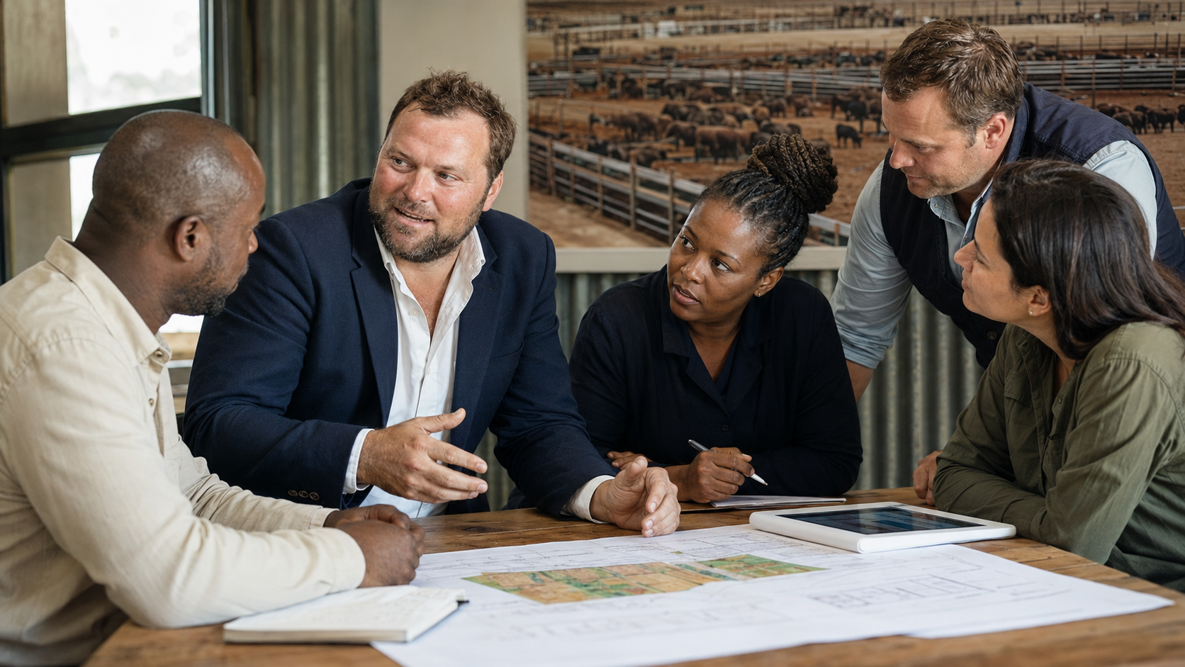
SENTRY CAPITAL
A boutique investment house built around real operating cash flows
The Sentry way
Originate gap-filling opportunities
Make operations and cash cycles legible
Align legal structure, controls and incentives
Deploy through an approved asset pipeline
Monitor evidence, collections and performance
HANDS-ON LEADERSHIP • ORIGINATION • ASSET MANAGEMENT
WHY BOUTIQUE
Specialist opportunities need close operating knowledge, decisive structuring and hands-on asset management.
Sentry fills financing gaps where real assets, specialist operators and controlled cash flows can create investable income.
CLIENT-FACING PRODUCT INFORMATION • FINAL • 9 SEPTEMBER 2026
02
Notes:
[Sources]
- Sentry Capital product, mandate and ECP materials supplied in the investor-document workspace.
- Leadership image is AI-generated identity-preserving marketing artwork using dd76eef0-0574-404b-8a06-daf7ee32c502.png as the primary multi-angle reference for Louis Pieterse, supported by louis 1.jpg, louis 4.jpg, louis2.jpg and louis3.jpg.
- The image depicts an illustrative collaborative Sentry investment and operating team in a candid working discussion.

Slide 3
THE PROPOSITION
Two specialist strategies. One diversified income mandate.
14.5%
14%+
13.5%
13%+
DIRECT PM • OPENING BLEND
DIRECT PM • TARGET
PLATFORM • OPENING BLEND
PLATFORM • TARGET
Opening portfolio blend
50%
Namibia Feedlot
13% strategy
50%
High-Value Specialty Agriculture
16% strategy
Why combine them?
The underlying investment strategies rely on different operating drivers, creating a diversified income engine supported by strategy-level monitoring and portfolio limits.
Opening blends reflect the initial strategy allocation and evolve with deployment, offtake and collection performance.
CLIENT-FACING PRODUCT INFORMATION • FINAL • 9 SEPTEMBER 2026
03
Notes:
[Sources]
- Sentry Capital mandate terms and master investor brochure, supplied 24 August 2026.

Slide 4
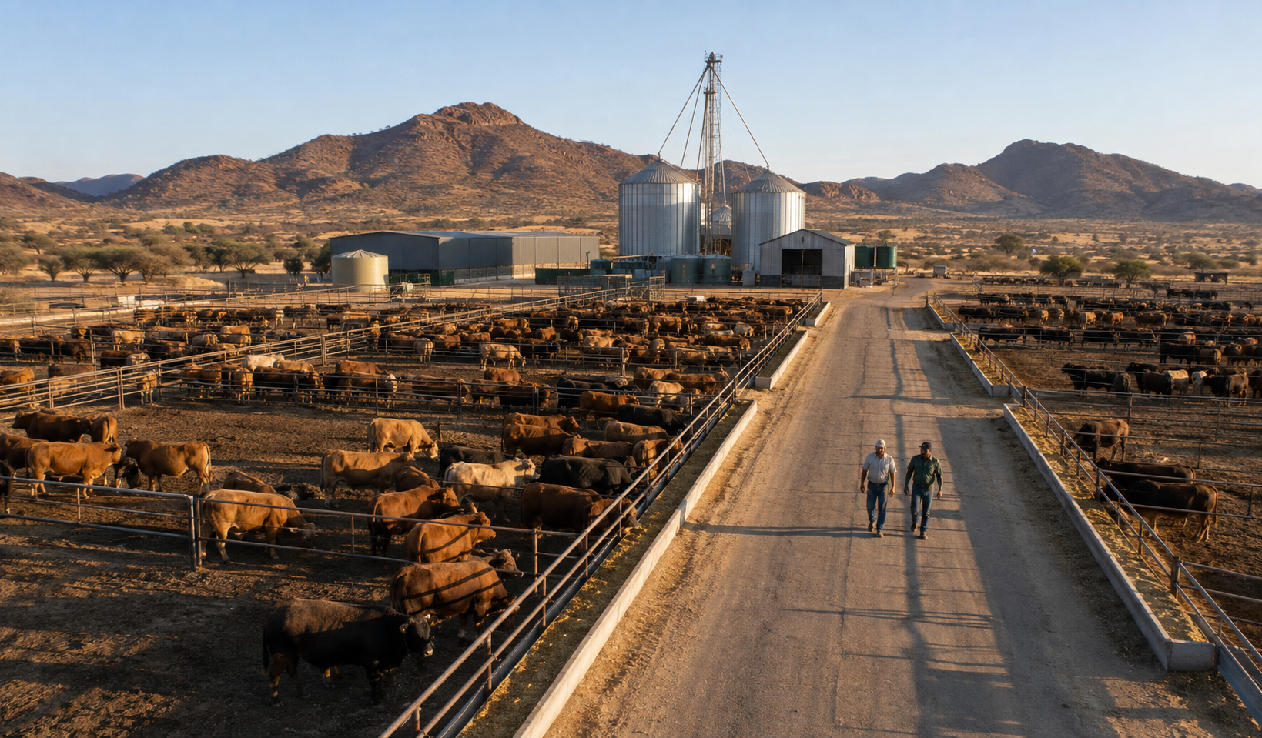
STRATEGY 1 • NAMIBIA FEEDLOT
A traceable beef platform with export and regional-supply optionality
Why the opportunity matters
Compliant sourcing and tag-level traceability
Controlled finishing and feed economics
Established regional and South African demand
Carcass specification and cut-level marketing
Future vertical and horizontal integration
ILLUSTRATIVE FEEDLOT AND FEED PRODUCTION
BIOSECURITY EDGE
Namibia retains a WOAH-recognised FMD-free zone without vaccination south of the Veterinary Cordon Fence, supporting export optionality for compliant supply.
South Africa’s 2026 FMD outbreaks reinforce the commercial value of traceable, secure and diversified beef supply.
CLIENT-FACING PRODUCT INFORMATION • FINAL • 9 SEPTEMBER 2026
04
Notes:
[Sources]
- Sentry Capital mandate terms and master investor brochure, supplied 24 August 2026.
- WOAH Namibia country update: https://rr-africa.woah.org/en/news/namibia-updates-tads-contingency-plans-safeguarding-animal-health-securing-livelihoods/
- South African Government FMD progress statement, 16 April 2026: https://www.gov.za/news/media-statements/minister-john-steenhuisen-announces-progress-foot-and-mouth-disease
- Namibia Livestock and Livestock Products Board: https://nammic.com.na/
- Namibia feedlot visual is AI-generated illustrative marketing artwork created for this presentation; it does not depict a specific current asset.

Slide 5
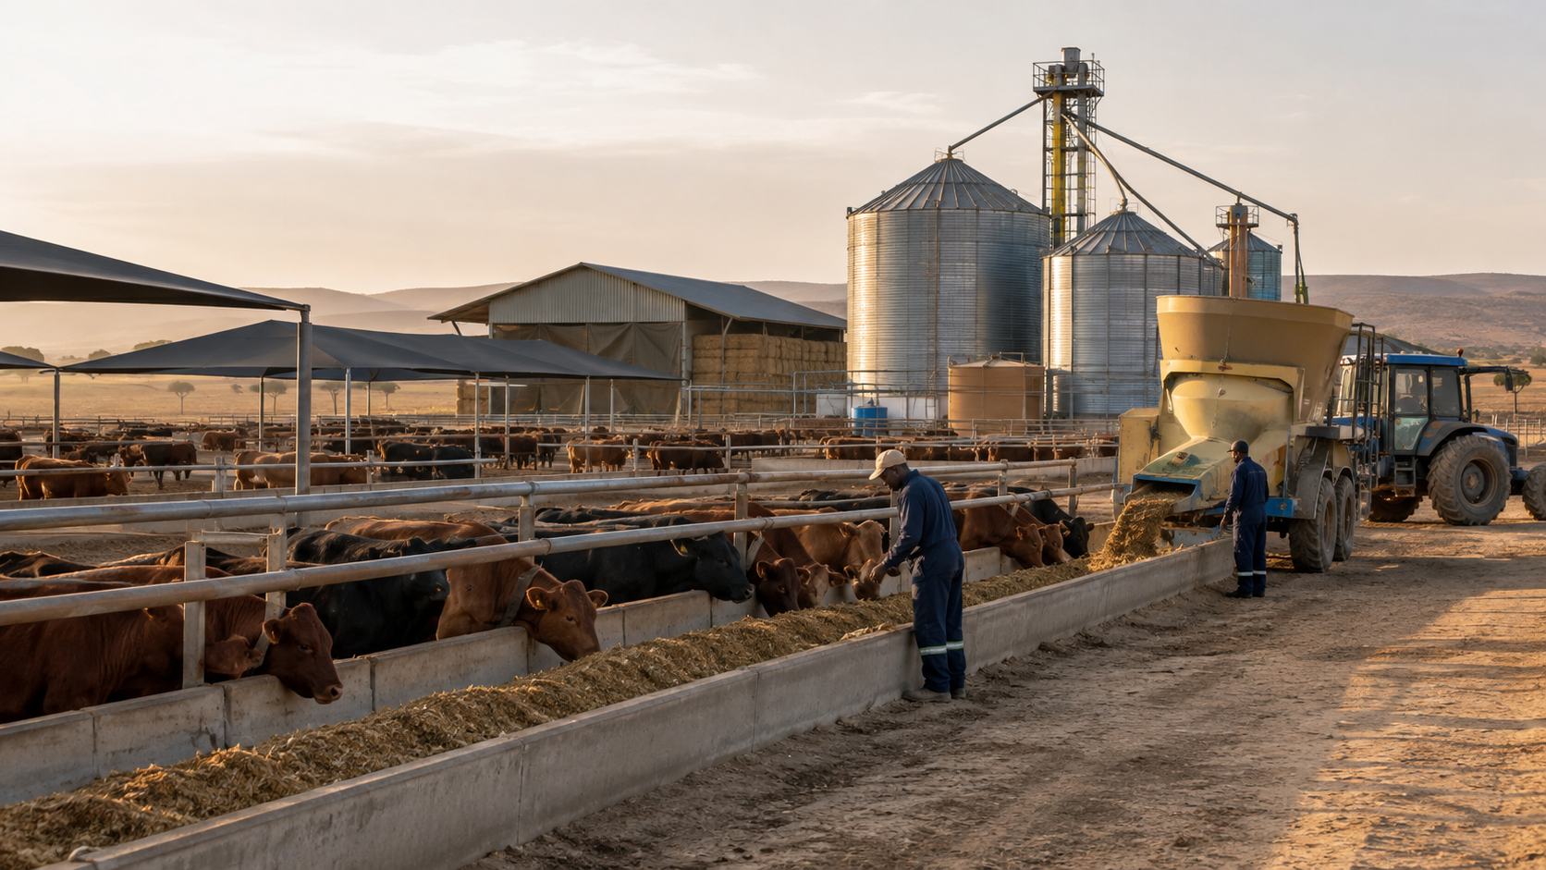
VALUE-CHAIN EXPANSION
Control more of the animal—and more of the margin
Integration path
Cattle sourcing, intake and ownership controls
Feed production, storage and efficiency
Finishing, health, weight and traceability data
Contracted slaughter, offtake and collections
Cut-specific sales, branded channels and future export
ILLUSTRATIVE FEEDLOT AND FEED PRODUCTION
COMMERCIAL LOGIC
Horizontal scale builds throughput; vertical integration expands control over feed, finishing, carcass specification, cuts and routes to market.
Sentry thesis: tighter value-chain control can improve supply reliability, marketing flexibility and margin visibility over time.
CLIENT-FACING PRODUCT INFORMATION • FINAL • 9 SEPTEMBER 2026
05
Notes:
[Sources]
- Sentry Capital mandate terms and master investor brochure, supplied 24 August 2026.
- Operational image is illustrative AI-generated marketing artwork; it does not depict a specific current portfolio asset.
[Sources]
- Meatco premium, traceable and value-added export positioning: https://www.meatco.com.na/index/news_item/52
- Project integration thesis supplied by Sentry management, 25 August 2026.

Slide 6
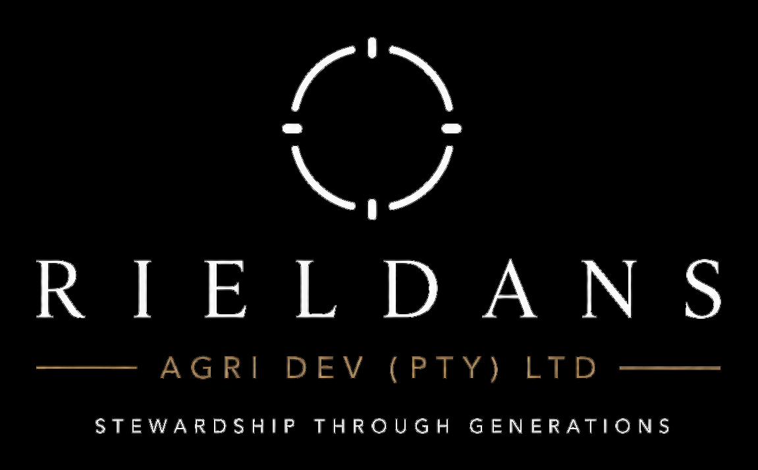
STRATEGY 2 • GARIEP / RIELDANS
A desert river becomes a premium food platform
What is being built
15.5 ha Beauvallon trial area
Up to ~5 ha intensive POC
Tomato-led protected production
Packhouse, cold chain and processing
Four-farm corridor matched to climate
GARIEP CONSUMER BRAND • RIELDANS OPERATING STEWARD
TWO NAMES, ONE ORIGIN
Gariep is the consumer brand. Rieldans Agri Development is the steward and operating company.
Lower Orange River • Richtersveld • Northern Cape • residue-free positioning
CLIENT-FACING PRODUCT INFORMATION • FINAL • 9 SEPTEMBER 2026
06
Notes:
[Sources]
- 2026-08-24_Gariep_Investor_Information_Pack(1).pdf, pages 1, 4-8; supplied by the user.
- Gariep/Rieldans brand or project image extracted from 2026-08-24_Gariep_Investor_Information_Pack(1).pdf.

Slide 7
WHERE • LOWER ORANGE RIVER
Four farms. One ~20 km climate corridor.
1
2
3
4
ALEXANDER BAY • FOG
BEAUVALLON • TRIAL
BRANDKAROS • HUB
ARRIESDRIFT • HEAT
Plant each crop where the climate fits
W
Fog crops
Finger lime • wasabi • vanilla
E
Heat crops
Tomato • ginger • dragon fruit
Why the corridor matters
A short drive changes fog, humidity and summer heat. The operating model assigns crops to the farm where each climate is most honest, instead of forcing one greenhouse recipe everywhere.
WEST Alexander Bay → Beauvallon → Brandkaros → Arriesdrift EAST
CLIENT-FACING PRODUCT INFORMATION • FINAL • 9 SEPTEMBER 2026
07
Notes:
[Sources]
- 2026-08-24_Gariep_Investor_Information_Pack(1).pdf, pages 6-7; supplied by the user.

Slide 8
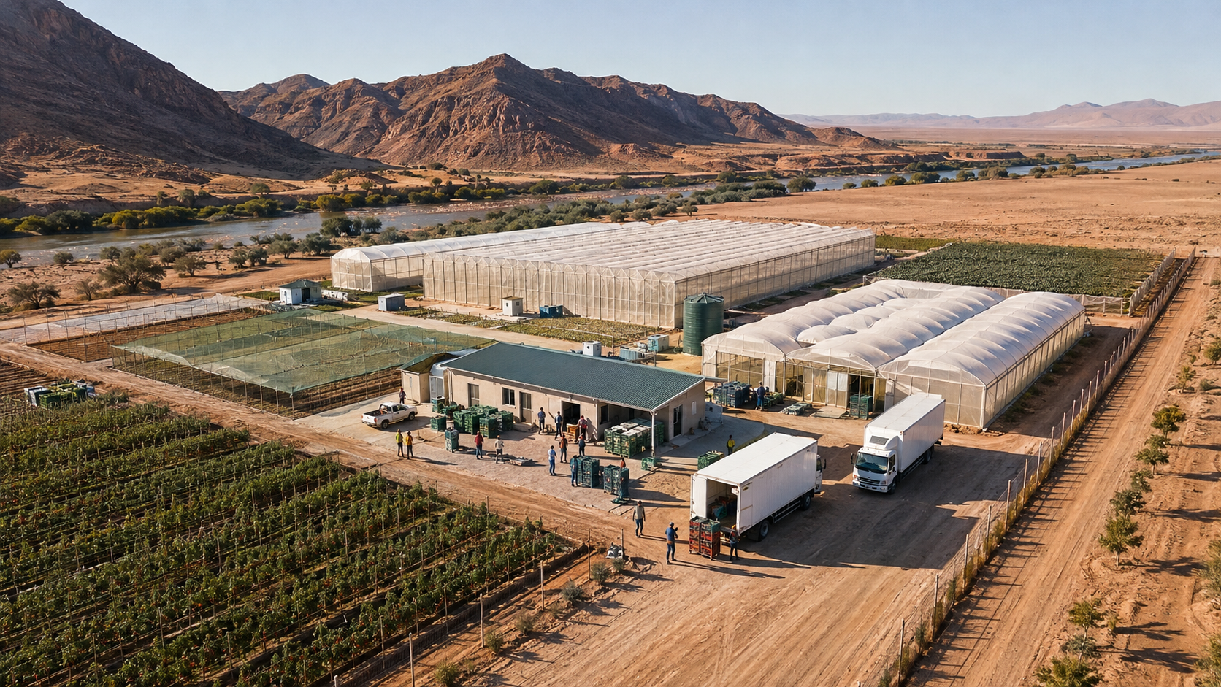

BEAUVALLON • 24-MONTH POC
Tomato pays for the platform; trial bays qualify the next crops
5.0 ha intensive plan
What the POC must prove
3.0 ha cherry / baby plum
1.5 ha heirloom tomato
Water, climate and protected-structure performance
0.15 ha strawberry trial
Residue protocol, yield, quality and pack-out
0.35 ha specialist trials
Premium retail and food-service demand
Bay-by-bay evidence for the next crops
GARIEP TOMATO • COMMERCIAL BAYS + CONTROLLED TRIALS
PROVE BEFORE SCALE
The 15.5 ha Beauvallon area contains up to ~5 ha of intensive production; tomato is the cash engine while smaller bays generate evidence.
5.0 ha intensive plan • 4.5 ha tomato • 0.5 ha controlled trials
CLIENT-FACING PRODUCT INFORMATION • FINAL • 9 SEPTEMBER 2026
08
Notes:
[Sources]
- 2026-08-24_Gariep_Investor_Information_Pack(1).pdf, pages 4, 11, 25; supplied by the user.
- Gariep/Rieldans brand or project image extracted from 2026-08-24_Gariep_Investor_Information_Pack(1).pdf.

Slide 9
GATED DEVELOPMENT PATH • MANAGEMENT PLAN
From a 5 ha POC to a planned 74 ha corridor
Development sequence
What each gate unlocks
15.5 ha Beauvallon area
Up to ~5 ha intensive POC
Verified water, climate and yield data
~20 ha first Brandkaros plateau
Commercial packhouse and cold chain
74 ha corridor management plan
Planned processing for non-premium fruit
Multi-farm crops and later export
LOWER ORANGE RIVER • A FOUR-FARM DEVELOPMENT CORRIDOR
SOCIAL + COMMERCIAL SCALE
The management plan uses ~15 direct jobs per developed hectare, plus construction, logistics, maintenance and processing roles.
Scale follows operating evidence and the Brandkaros gate review
CLIENT-FACING PRODUCT INFORMATION • FINAL • 9 SEPTEMBER 2026
09
Notes:
[Sources]
- 2026-08-24_Gariep_Investor_Information_Pack(1).pdf, pages 5, 8 and 26; supplied by the user.
- Protected-agriculture corridor visual is AI-generated illustrative marketing artwork created for this presentation; it does not depict a completed current asset.

Slide 10

WHY HERE • LOWER ORANGE RIVER
Dryness and light support residue-free positioning
Climate as a production asset
Irrigation water through a desert
High light and a large day–night range
Low rainfall, humidity and fungal pressure
Protected structures convert climate into consistency
On-farm stations manage climate by kilometre
AUTHENTIC RICHTERSVELD / LOWER ORANGE LANDSCAPE
OPERATING IMPLICATION
At Brandkaros, controlled-environment agriculture is primarily a summer cooling-and-light challenge—not a coastal heating-and-fungicide model.
Plant the west for fog crops; the east for heat crops
CLIENT-FACING PRODUCT INFORMATION • FINAL • 9 SEPTEMBER 2026
10
Notes:
[Sources]
- 2026-08-24_Gariep_Investor_Information_Pack(1).pdf, pages 7-8; supplied by the user.
- Gariep/Rieldans brand or project image extracted from 2026-08-24_Gariep_Investor_Information_Pack(1).pdf.

Slide 11
GARIEP BRAND • VALUE-CHAIN EXPANSION
A food brand—not a commodity tomato
Routes to market
Premium retail
Food service and hospitality
Chefs and speciality produce
Processing: passata, bases and ingredients
Export after domestic scale and packhouse
GARIEP • PREMIUM / RESIDUE-FREE / TRACEABLE POSITIONING
BRAND + PROCESSING LOGIC
Premium fresh product leads. The management plan routes roughly 30% of tomato into processing to absorb grade-outs and build value-added products.
Gariep is designed for repeatable quality, traceability and a recognisable consumer story
CLIENT-FACING PRODUCT INFORMATION • FINAL • 9 SEPTEMBER 2026
11
Notes:
[Sources]
- 2026-08-24_Gariep_Investor_Information_Pack(1).pdf, pages 5, 9-10, 26; supplied by the user.
- Gariep/Rieldans brand or project image extracted from 2026-08-24_Gariep_Investor_Information_Pack(1).pdf.

Slide 12
RETURN COMPARISON
The opening blend currently exceeds CPI + 8%
Annualised reference comparison
Reference comparison shown on an annualised arithmetic basis.
+1.20 pp
CPI + 8%
12.30%
Platform opening blend
above CPI + 8%
SENB • Platform target floor
13.00%
SENB • Platform opening blend
13.50%
+2.20 pp
Direct PM target floor
14.00%
Direct PM opening blend
above CPI + 8%
Direct PM opening blend
14.50%
Target returns are mandate objectives; realised outcomes reflect fees, tax, deployment timing, strategy weights and portfolio performance.
CLIENT-FACING PRODUCT INFORMATION • FINAL • 9 SEPTEMBER 2026
12
Notes:
[Sources]
- Statistics South Africa, Consumer inflation slows in July 2026: CPI 4.30%; CPI + 8% arithmetic equals 12.30% — https://www.statssa.gov.za/?p=19815
- Sentry Capital mandate terms and master investor brochure, supplied 24 August 2026.

Slide 13
CAPITAL GUARDIANSHIP • THE SENTRY WAY
Two specialist strategies. One connected control framework.
FEEDLOT CONTROL SET
AGRICULTURE CONTROL SET
Tag-level animal and batch records
Water, climate and infrastructure evidence
Operator capacity and health controls
POC economics before material scale
Feed-cost and weight-gain monitoring
Retail and food-service offtake
Price grid, offtake and payer terms
Residue, yield, quality and pack-out monitoring
Title, collection and FX controls
Brandkaros gate, strategy limits and liquidity
Portfolio-level controls
Strategy caps • Counterparty limits • FX and liquidity management • Independent reporting • Re-underwriting
Active asset management connects operating evidence, title, security, collection controls, reserves, reporting and re-underwriting.
CLIENT-FACING PRODUCT INFORMATION • FINAL • 9 SEPTEMBER 2026
13
Notes:
[Sources]
- Sentry Capital mandate terms and master investor brochure, supplied 24 August 2026.
[Sources]
- 2026-08-24_Gariep_Investor_Information_Pack(1).pdf, pages 8, 25, 27; supplied by the user.

Slide 14
MANDATE OVERVIEW
One product. Two access routes.
HOW THE STRUCTURE WORKS
PLATFORM / NOMINEE ROUTE
Dynamic Income is available through Direct Private Markets and approved platform or nominee channels. Direct clients use the SC3 and Short-Form ECP for Series B; platform clients participate under platform or nominee terms. Each route has its own documents and administration.
Series code • SENTRY-B
LIFECYCLE PLATFORM CODE • SENB
Direct route • Subsequent Limited Partner via SC3
Platform route • contractual participation under platform or nominee terms
DIRECT ROUTE
100% of net investable capital targeted within 21 days
Short-Form ECP + SC3
Subsequent Limited Partner route
ACCESS
Platform and Direct PM routes provide access to the same strategy family with route-specific administration and economics.
Short-Form ECP + SC3 • Series B • SENTRY-B • SENB
CLIENT-FACING PRODUCT INFORMATION • FINAL • 9 SEPTEMBER 2026
14
Notes:
[Sources]
- Sentry Capital mandate terms and master investor brochure, supplied 24 August 2026.

Slide 15
INVESTOR FAQ • DYNAMIC INCOME
The return and platform terms in plain language
WHAT IS A TARGET RETURN?
WHAT DOES 100% ALLOCATED MEAN?
A mandate objective—not a contractual fixed return.
100% of net investable capital is targeted for allocation within 21 days.
WHAT IS THE OPENING BLEND?
HOW IS LIQUIDITY DESIGNED?
The weighted starting profile based on the initial strategy allocation.
Around production cycles, collections, reserves and the contractual term.
WHAT IS THE GARIEP STRATEGY?
WHAT REPLACES ‘SLEEVE’?
Tomato-led protected production, controlled crop trials, branding and planned processing across a gated four-farm corridor.
Underlying investment strategy, strategy allocation or investment segment.
DIRECT OR PLATFORM ROUTE
Direct clients join Series B through SC3 and the Short-Form ECP. Platform clients participate through platform or nominee terms.
The applicable Series Supplement and route documents define the target, term, access route, liquidity and administration.
CLIENT-FACING PRODUCT INFORMATION • FINAL • 9 SEPTEMBER 2026
15
Notes:
[Sources]
- Sentry Capital mandate terms and master investor brochure, supplied 24 August 2026.
[Sources]
- 2026-08-24_Gariep_Investor_Information_Pack(1).pdf, pages 4-11, 25-26; supplied by the user.

Slide 16
MANDATE OVERVIEW
Dynamic Income • specialist real-economy strategies, actively managed
DESIGNED FOR
What the mandate brings together
For investors seeking diversified target income from feedlot and protected-agriculture strategies with close operating oversight.
Two specialist real-economy income strategies
Feedlot batch economics and contracted offtake
Gariep tomato-led protected production and crop trials
Portfolio diversification and strategy-level monitoring
Launch terms
Target returns and opening blend by access route
Year 3–Year 7
Moderate product risk classification: 3 of 5
LIFECYCLE ACCESS
SENB • Dynamic Income • Short-Form ECP + SC3 Series B • SENTRY-B
Moderate risk / 3 of 5 • client fees: 1.50% once-off Year 1 • 0.50% p.a. from Year 2 under written mandate
CLIENT-FACING PRODUCT INFORMATION • FINAL • 9 SEPTEMBER 2026
16
Notes:
[Sources]
- Sentry Capital mandate terms and master investor brochure, supplied 24 August 2026.
[Sources]
- 2026-08-24_Gariep_Investor_Information_Pack(1).pdf, pages 4-11; supplied by the user.

