Slide 1
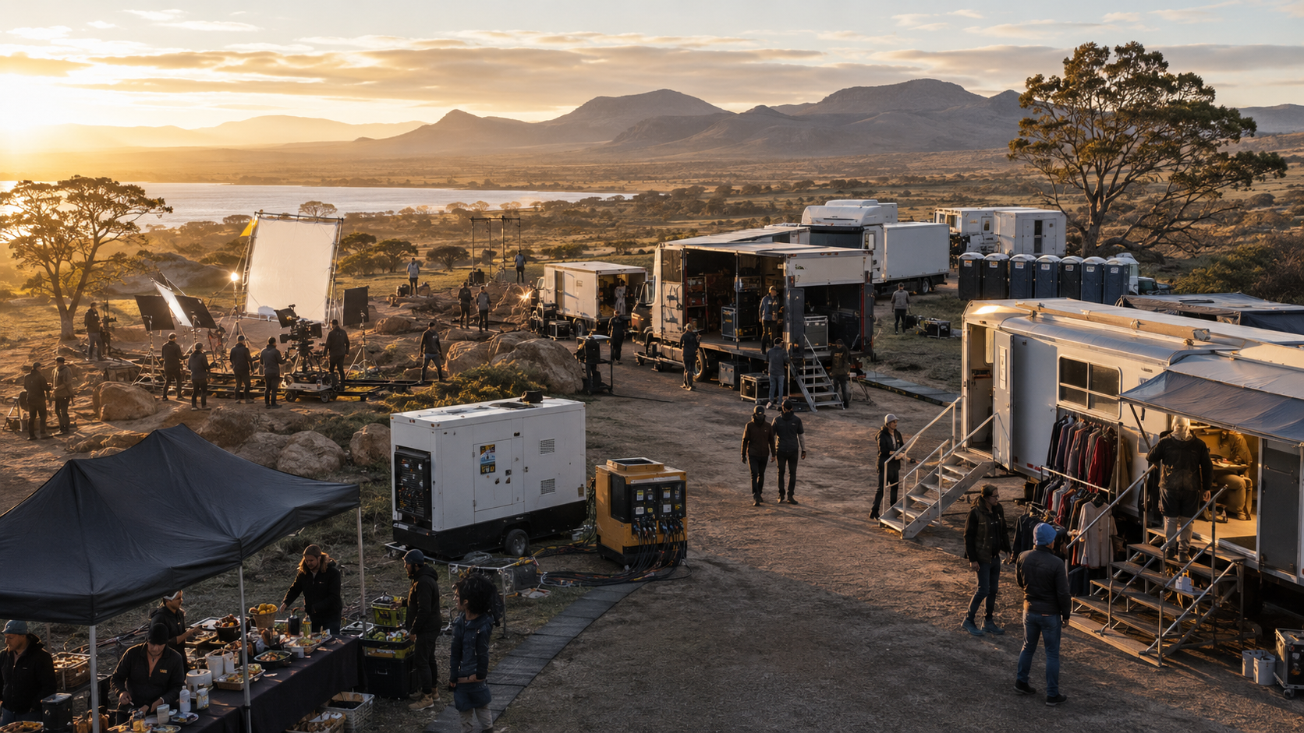
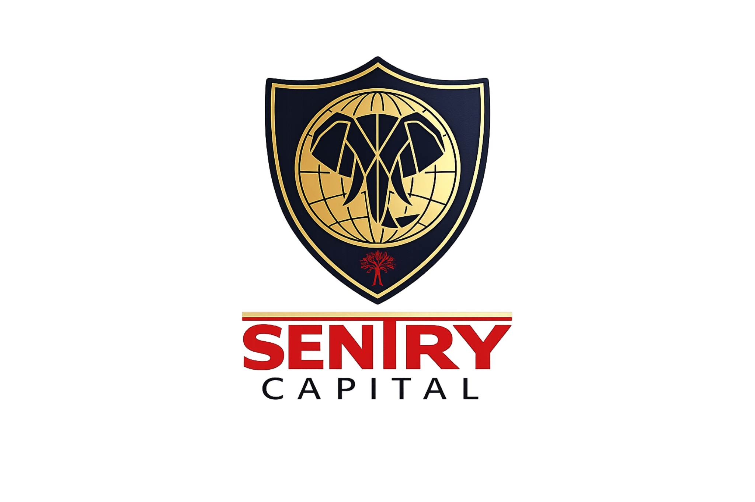
SENTRY CAPITAL PRODUCT PRESENTATION
Optimal
Growth
Contract-backed media income with contingent participation in realised project upside.
SENC | Direct PM 13% base | Platform 12% base
LIFECYCLE PLATFORM CODE • SENC
Potential maturity upside: 1–8% of original capital • Year 3–Year 5
CLIENT-FACING PRODUCT INFORMATION • FINAL • 9 SEPTEMBER 2026
Notes:
[Sources]
- Sentry Capital mandate terms and master investor brochure, supplied 24 August 2026.
- Operational image is illustrative AI-generated marketing artwork; it does not depict a specific current portfolio asset.
[Sources]
- Accenture Investor Relations, official earnings and investor materials: https://investor.accenture.com/ (visual design benchmark only).
- Accenture Annual Reports: https://www.accenture.com/us-en/about/company/annual-report (visual design benchmark only).

Slide 2
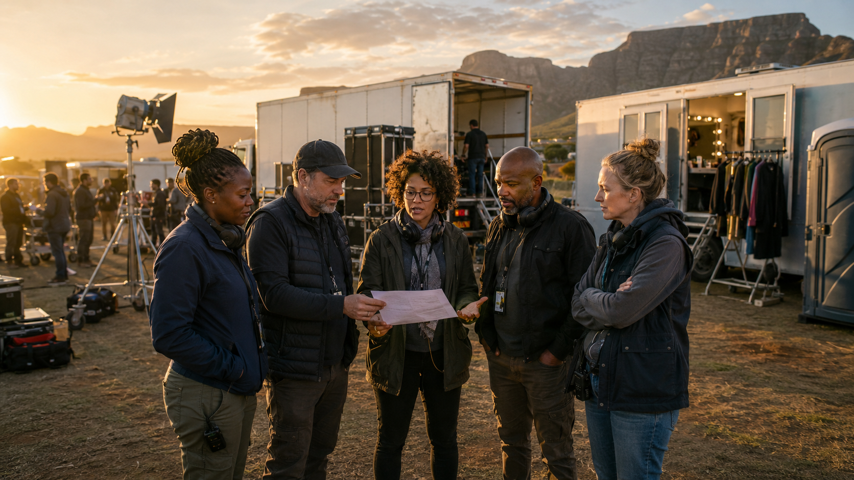
SENTRY CAPITAL
A boutique investment house for contract-backed creative assets
3
100%
DIFFERENTIATED MANDATE • TWO ACCESS ROUTES
OF CLEARED SUBSCRIPTION FUNDS DEPLOYED WITHIN 21 DAYS
BESPOKE
REAL-ASSET + IP OPPORTUNITIES
Sentry fills financing and infrastructure gaps that conventional asset classes often overlook.
We originate and actively manage private-market investments anchored in contracts, receivables, production infrastructure and defensible intellectual property.
BESPOKE ORIGINATION • STRUCTURING • ASSET MANAGEMENT
Liquidity is designed around contractual project cash flows, collection timing and the term of the Series.
CLIENT-FACING PRODUCT INFORMATION • FINAL • 9 SEPTEMBER 2026
02
Notes:
[Sources]
- Sentry Capital mandate terms and master investor brochure, supplied 24 August 2026.
- Operational image is illustrative AI-generated marketing artwork; it does not depict a specific current portfolio asset.
[Sources]
- Sentry Capital product and ECP materials supplied in the investor-document workspace.
- OpenAI-generated illustrative team image; does not depict a specific portfolio company or employee.

Slide 3
THE SOUTH AFRICAN PRODUCTION EDGE
Rand budgets can create globally competitive screen value
The commercial edge is not a literal rand-for-dollar equivalence.
It comes from experienced local crews, diverse locations, exchange-rate economics, specialist suppliers and qualifying production incentives.
GLOBAL SCREEN VALUE
QUALIFYING INCENTIVE
LOCAL ECOSYSTEM
South African productions can translate local budgets into premium production quality.
35% of QSAPE plus a conditional 5%—up to 40% of qualifying spend, subject to eligibility and approval.
Crews, locations, equipment, production services and post-production capability.
INFRASTRUCTURE GAP
IP PIPELINE
Limited specialist infrastructure can create rental and service opportunities beyond one production.
Books, screen rights, developed concepts and repeat creative partnerships can compound future value.
A R50 million South African production can deliver screen value associated with materially larger hard-currency budgets—through cost structure, capability and incentive efficiency.
CLIENT-FACING PRODUCT INFORMATION • FINAL • 9 SEPTEMBER 2026
03
Notes:
[Sources]
- Sentry Capital mandate terms and master investor brochure, supplied 24 August 2026.
[Sources]
- the dtic South African Film and Television Production Incentive: https://www.thedtic.gov.za/south-african-film-and-television-production-incentive/
- Programme mechanics: 35% of QSAPE plus conditional 5%, subject to eligibility and approval; not 40% of total budget.
- Comparative production-value thesis supplied by Sentry management and presented as a commercial proposition, not currency equivalence.

Slide 4
THE PROPOSITION
The base case is contract-backed; creative success is optional upside
13%
12%
DIRECT PM • BASE P.A., COMPOUNDED
PLATFORM • BASE P.A., COMPOUNDED
1–8%
potential maturity upside
of original capital
Paid from realised distributable profit and presented separately from the annual base return.
The investment thesis prioritises executed contracts, receivables, service revenue and defensible IP rights. Project success can add participation, while the base case remains anchored in contracted cash flows.
ILLUSTRATIVE FILM AND MEDIA SUPPORT SERVICES
Project selection prioritises completion readiness, contracted counterparties, defensible IP, controlled collections and liquidity planning.
CLIENT-FACING PRODUCT INFORMATION • FINAL • 9 SEPTEMBER 2026
04
Notes:
[Sources]
- Sentry Capital mandate terms and master investor brochure, supplied 24 August 2026.
- Operational image is illustrative AI-generated marketing artwork; it does not depict a specific current portfolio asset.
[Sources]
- Sentry Capital Optimal Growth mandate terms supplied in the investor-document workspace.

Slide 5
THE PROPOSITION
Infrastructure scarcity creates a second revenue layer
01
02
TRUCKS • POWER • GRIP • CAMERA • EQUIPMENT
CAST TRAILERS • MOBILE OFFICES • SANITATION
03
MULTI-USE ASSET RENTAL
Infrastructure can serve Sentry-backed projects and third-party productions.
Support-service assets turn production scarcity into recurring commercial utility: transport, equipment, trailers, mobile offices, toilets, power and on-set facilities can earn across a wider production market.
ILLUSTRATIVE PRODUCTION + SUPPORT-SERVICE ECOSYSTEM
This expands the opportunity from project finance into an operating production-services platform.
CLIENT-FACING PRODUCT INFORMATION • FINAL • 9 SEPTEMBER 2026
05
Notes:
[Sources]
- Sentry Capital mandate terms and master investor brochure, supplied 24 August 2026.
- Operational image is illustrative AI-generated marketing artwork; it does not depict a specific current portfolio asset.
[Sources]
- Support-service opportunity and secondary-market thesis supplied by Sentry management, 25 August 2026.
- OpenAI-generated illustrative film-production image; does not depict a specific current production or employee.

Slide 6
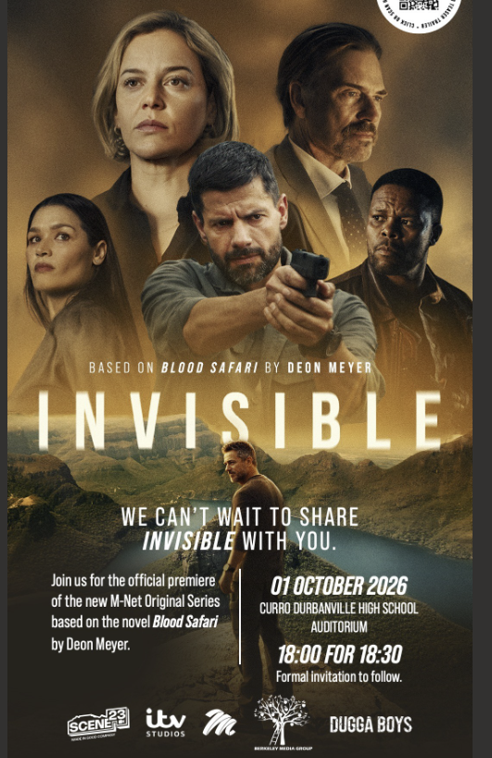

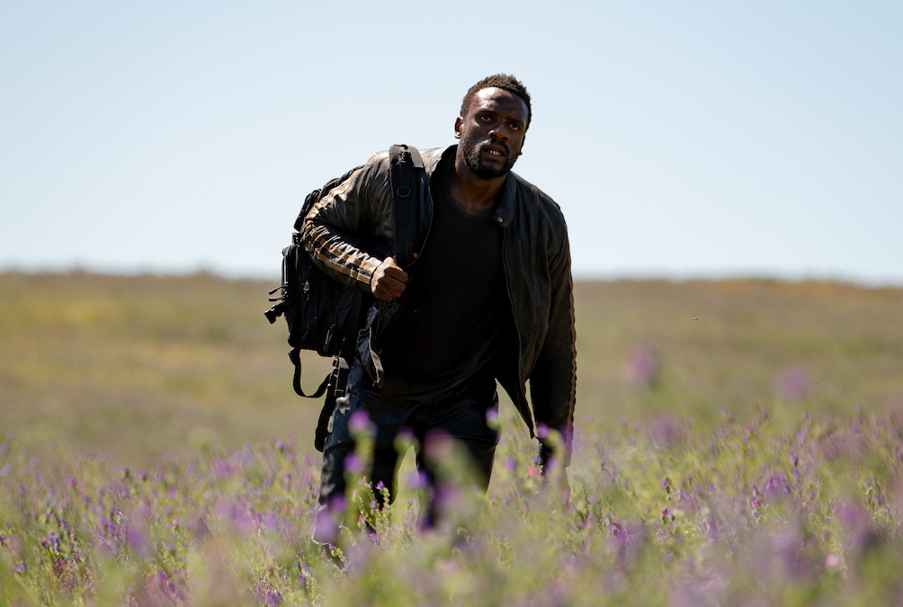
RELEVANT EXPERIENCE
Heart of the Hunter • completed project, global proof point
OFFICIAL NETFLIX STILLS • IMAGE CREDIT: MPUMELELO MACU / NETFLIX
Based on the Deon Meyer novel • released globally by Netflix on 29 March 2024
The film reached #1 on Netflix’s English Films list with 10.9 million views in the week of 1 April 2024.
CLIENT-FACING PRODUCT INFORMATION • FINAL • 9 SEPTEMBER 2026
06
Notes:
[Sources]
- Netflix Tudum, Heart of the Hunter release and title information — https://www.netflix.com/tudum/articles/heart-of-the-hunter-release-date-news
- About Netflix, official first-look press release — https://about.netflix.com/en/news/first-look-at-netflixs-newest-film-the-gripping-heart-of-the-hunter
- Official stills credited to Mpumelelo Macu / Netflix.
- Sentry Capital mandate terms and completed-project information, supplied 24 August 2026.
[Sources]
- Netflix title page: https://www.netflix.com/title/81579704
- Netflix first look and release date: https://about.netflix.com/en/news/first-look-at-netflixs-newest-film-the-gripping-heart-of-the-hunter
- Netflix Top 10 week of 1 April 2024: https://about.netflix.com/en/news/top-10-week-of-apr-1-3-body-problem-holds-strong-at-1

Slide 7
CURRENT PROJECT PIPELINE
Invisible • Deon Meyer IP moving from page to premium television
USER-SUPPLIED PREMIERE POSTER • ILLUSTRATIVE PRODUCTION IMAGE
Eight-part M-Net Original • produced with ITV Studios, Scene23 and Berkeley Media Group
Based on Blood Safari • Deon Meyer credited as creator • poster lists official premiere on 1 October 2026
CLIENT-FACING PRODUCT INFORMATION • FINAL • 9 SEPTEMBER 2026
07
Notes:
[Sources]
- Netflix Tudum, Heart of the Hunter release and title information — https://www.netflix.com/tudum/articles/heart-of-the-hunter-release-date-news
- About Netflix, official first-look press release — https://about.netflix.com/en/news/first-look-at-netflixs-newest-film-the-gripping-heart-of-the-hunter
- Official stills credited to Mpumelelo Macu / Netflix.
- Sentry Capital mandate terms and completed-project information, supplied 24 August 2026.
[Sources]
- M-Net announcement: https://www.dstv.com/m-net/en-sn/news/abbie-cornish-and-dougray-scott-lead-the-invisible_5539
- User-supplied Invisible premiere poster: file_00000000ade48243a13b0eb29f224b03.
- OpenAI-generated illustrative production image; does not depict the Invisible production.

Slide 8
THE IP + PRODUCTION FLYWHEEL
IP ownership creates a repeatable pipeline—not a single-production bet
A screen project can generate more than a once-off production fee.
Sentry’s thesis links source IP, development, contracted production, reusable infrastructure and future library value.
SOURCE IP
DEVELOPMENT
CONTRACTS
Books, licensed rights and original concepts create the starting asset.
Writing, packaging, budgeting and attachments convert ideas into financeable projects.
Broadcaster, streamer, presale, distribution and service agreements anchor cash flows.
PRODUCTION SERVICES
LIBRARY VALUE
Reusable equipment and infrastructure earn within and beyond Sentry-backed projects.
Completed works, sequels, adaptations and distribution rights can extend the pipeline.
Deon Meyer is central to the creative pipeline as source author and creator across completed and current projects.
CLIENT-FACING PRODUCT INFORMATION • FINAL • 9 SEPTEMBER 2026
08
Notes:
[Sources]
- Sentry Capital mandate terms and master investor brochure, supplied 24 August 2026.
[Sources]
- Project/IP pipeline thesis supplied by Sentry management, 25 August 2026.
- M-Net announcement identifies Deon Meyer as creator of Invisible: https://www.dstv.com/m-net/en-sn/news/abbie-cornish-and-dougray-scott-lead-the-invisible_5539

Slide 9
RETURN COMPARISON
Direct PM base exceeds CPI + 8%, while Platform base remains close to the reference
Annualised base-return comparison
Reference comparison shown on an annualised arithmetic basis.
−0.30 pp
Platform base vs
CPI + 8%
SENC • Platform base
12.00%
CPI + 8%
12.30%
+0.70 pp
Direct PM base vs
CPI + 8%
Direct PM base
13.00%
Contingent maturity upside is shown separately: 1–8% of original capital, payable from realised distributable profit.
Realised outcomes reflect project performance, distributable profit, fees, tax, timing and cash collections.
CLIENT-FACING PRODUCT INFORMATION • FINAL • 9 SEPTEMBER 2026
09
Notes:
[Sources]
- Statistics South Africa, Consumer inflation slows in July 2026: CPI 4.30%; CPI + 8% arithmetic equals 12.30% — https://www.statssa.gov.za/?p=19815
- Sentry Capital mandate terms and master investor brochure, supplied 24 August 2026.

Slide 10
CAPITAL GUARDIANSHIP • THE SENTRY WAY
Contracts, collections and completion readiness come first
1
2
3
4
→
→
→
Collect
Protect
Service
Share
All project receipts
Approved costs and reserves
Base return and principal
Only realised residual profit
Project-selection foundations
VALUE PROTECTION PRIORITIES
Verified chain of title and defensible rights
Completion readiness • Budget discipline • Delivery quality • Contracted payments • Presale strength • Defensible IP • Rebate administration • Controlled cash flows • FX management • Realised upside
Executed distribution, presale, MG or service contracts
Budget, contingency, milestone and completion planning
Controlled collections and payment waterfall
Counterparty, concentration, FX, rebate and valuation parameters
Active asset management connects chain of title, budgets, milestones, completion, controlled collections, base servicing and only then realised residual profit.
CLIENT-FACING PRODUCT INFORMATION • FINAL • 9 SEPTEMBER 2026
10
Notes:
[Sources]
- Sentry Capital mandate terms and master investor brochure, supplied 24 August 2026.

Slide 11
MANDATE OVERVIEW
One product. Two access routes.
HOW THE STRUCTURE WORKS
PLATFORM / NOMINEE ROUTE
Optimal Growth is available through Direct Private Markets and approved platform or nominee channels. Direct clients use the SC3 and Short-Form ECP for Series C; platform clients participate under platform or nominee terms. Each route has its own documents and administration.
Series code • SENTRY-C
LIFECYCLE PLATFORM CODE • SENC
Base return • annual contracted return component
Maturity upside • contingent, paid from realised distributable profit
DIRECT ROUTE
Direct route • Subsequent Limited Partner via SC3
Short-Form ECP + SC3
Subsequent Limited Partner route
CAPITAL DEPLOYMENT
100% of net investable capital is targeted for allocation within 21 days.
Short-Form ECP + SC3 • Series C • SENTRY-C • SENC
CLIENT-FACING PRODUCT INFORMATION • FINAL • 9 SEPTEMBER 2026
11
Notes:
[Sources]
- Sentry Capital mandate terms and master investor brochure, supplied 24 August 2026.

Slide 12
MANDATE OVERVIEW
Optimal Growth • contract-backed media income with an IP pipeline
DESIGNED FOR
What the mandate brings together
For investors seeking a contract-backed media income base, actively managed production assets and participation in realised project upside.
Contract-backed base-return framework
Film, media and production-support cash flows
Defensible rights and controlled collections
Base return supported before upside participation
Launch terms
Potential maturity participation from realised profit
Year 3–Year 5
Moderate product risk classification: 3 of 5
LIFECYCLE ACCESS
SENC • Optimal Growth • Short-Form ECP + SC3 Series C • SENTRY-C
Moderate risk / 3 of 5 • client fees: 1.50% once-off Year 1 • 0.50% p.a. from Year 2 under written mandate
CLIENT-FACING PRODUCT INFORMATION • FINAL • 9 SEPTEMBER 2026
12
Notes:
[Sources]
- Sentry Capital mandate terms and master investor brochure, supplied 24 August 2026.

