Slide 1

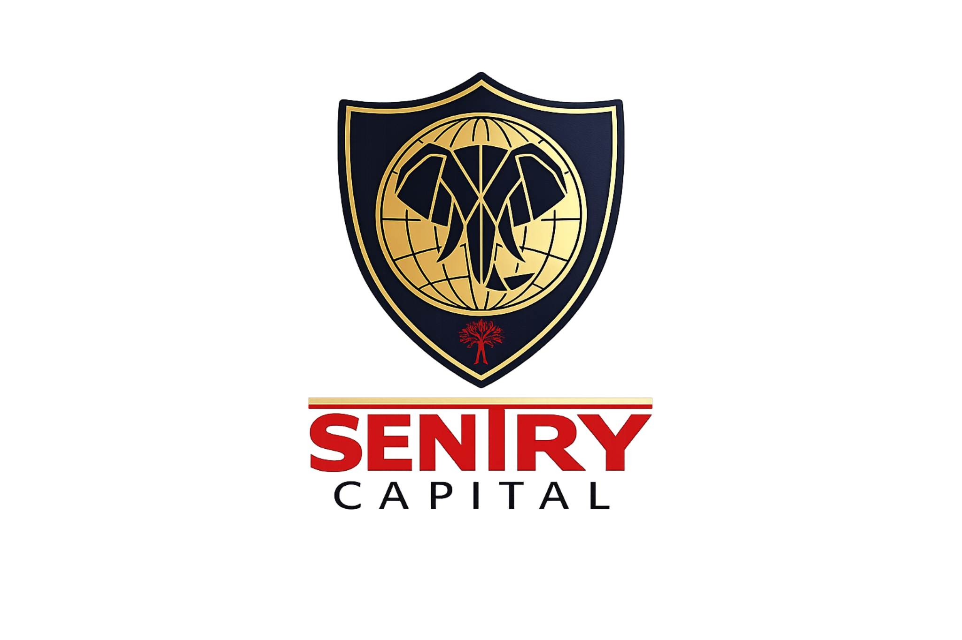
SENTRY CAPITAL PRODUCT PRESENTATION
Structured
Income
Contractual net income from verified, short-cycle working-capital transactions.
SENA | 13.65% Direct fixed net | 12.65% Platform fixed net
LIFECYCLE PLATFORM CODE • SENA
Launch terms: Year 1–Year 7 • Typical cycle: 30–90 days
CLIENT-FACING PRODUCT INFORMATION • FINAL • 9 SEPTEMBER 2026
Notes:
[Sources]
- Sentry Capital Structured Income fund factsheet, 26 August 2026.
- Accenture investor materials were used only as a visual-design benchmark: https://investor.accenture.com/

Slide 2

SENTRY CAPITAL
A boutique investment house for overlooked real-economy opportunities
R200m
APPROX. UNDERLYING MANAGED CAPITAL
100%
OF NET INVESTABLE CAPITAL TARGETED WITHIN 21 DAYS
Sentry originates, structures and actively manages bespoke private-market investments that finance specific gaps in the economy—where specialist knowledge and close asset oversight can create an edge.
BOUTIQUE ORIGINATION • ACTIVE ASSET MANAGEMENT
THE SENTRY WAY
Find a real operating gap. Make the asset and cash cycle legible. Build contractual controls. Stay close to evidence, collections and performance.
Sponsor-reported 36+ months operating history across short-cycle, evidence-led transactions.
CLIENT-FACING PRODUCT INFORMATION • FINAL • 9 SEPTEMBER 2026
02
Notes:
[Sources]
- Sentry Capital Structured Income fund factsheet, 26 August 2026.
- Sentry Capital sponsor-confirmed underlying managed-capital scale and operating history, supplied in the investor-document workspace.
- OpenAI-generated leadership-team image based on user-supplied Louis Pieterse reference photographs, 26 August 2026. Illustrative team setting; only Louis's likeness is reference-based.

Slide 3
WHY THE NICHE EXISTS
South Africa’s SME funding gap is large—and highly specific
The market gap
WHY SENTRY CAN COMPETE
Only about 5% of formal South African MSMEs have access to credit. Yet SMEs contribute roughly 34% of economic output and 60% of jobs.
The opportunity is not generic small-business lending. It is a defined financing need connected to a verified economic event.
01
A confirmed economic event
The need is transactional
Order, value, payer and settlement terms are independently confirmed.
Inputs against verified orders
02
Evidence-led underwriting
Supplier capability, costs, milestones and exceptions are tested.
Labour and delivery capacity
Logistics and fulfilment
03
A controlled route to cash
Funding, delivery evidence, collection accounts and reconciliations are controlled.
Short-dated receivable conversion
Structured Income targets specific, verified working-capital events within this broader credit gap.
CLIENT-FACING PRODUCT INFORMATION • FINAL • 9 SEPTEMBER 2026
03
Notes:
[Sources]
- IFC and FirstRand partnership release, 18 September 2025: https://www.ifc.org/en/pressroom/2025/ifc-and-firstrand-bank-partner-to-widen-access-to-finance-for-small-businesses-in-
- Sentry Capital Structured Income fund factsheet, 26 August 2026.

Slide 4
THE PROPOSITION
Capital is matched to verified operating cycles
13.65%
DIRECT PM • FIXED NET P.A., COMPOUNDED
12.65%
PLATFORM • FIXED NET P.A., COMPOUNDED
100% of net investable capital is targeted for allocation within 21 days through an approved asset pipeline and capital-release process. Each allocation is matched to a specific purchase order or receivable cycle.
ILLUSTRATIVE OPERATING-CAPITAL FINANCE
WHY THE STRUCTURE MATTERS
The short tenor improves evidence frequency and capital recycling; close verification, exception management and collection controls remain central.
Fixed net means the contractual client return after applicable product or route charges and before investor-specific tax.
CLIENT-FACING PRODUCT INFORMATION • FINAL • 9 SEPTEMBER 2026
04
Notes:
[Sources]
- Sentry Capital Structured Income fund factsheet, 26 August 2026.
- Sentry Capital approved capital-allocation wording supplied in the investor-document workspace.

Slide 5
EVIDENCE-LED TRANSACTION PATH
Capital is released only as evidence accumulates
1
2
3
4
5
→
→
→
→
Originate
Verify
Fund
Evidence
Collect
Identify a short-cycle, contract-backed need.
Confirm PO, payer, supplier and economics.
Release cash against approved milestones.
Capture delivery, acceptance and exceptions.
Route proceeds, reconcile and re-underwrite.
Why the evidence-led structure matters
ACTIVE MONITORING
Each transaction combines verification, controlled funding and delivery evidence so capital movement remains visible throughout the cycle.
Short cycles support frequent evidence checks, faster decision-making and timely resolution throughout the transaction.
CLIENT-FACING PRODUCT INFORMATION • FINAL • 9 SEPTEMBER 2026
05
Notes:
[Sources]
- Sentry Capital Structured Income fund factsheet and underwriting-process materials, 26 August 2026.

Slide 6
RETURN COMPARISON
The fixed net client returns are above the selected references
Annualised reference comparison
Reference comparison shown on an annualised arithmetic basis.
+0.65 pp
Platform above
JIBAR + 5%
July CPI
4.30%
3-month JIBAR + 5%
12.00%
+1.65 pp
SENA • Platform fixed net
12.65%
Direct PM above
JIBAR + 5%
Direct PM fixed net
13.65%
Above inflation: Platform +8.35 pp | Direct PM +9.35 pp
Net client return: after applicable product or route charges and before investor-specific tax.
CLIENT-FACING PRODUCT INFORMATION • FINAL • 9 SEPTEMBER 2026
06
Notes:
[Sources]
- Sentry Capital Structured Income fund factsheet, 26 August 2026.
- South African Reserve Bank, current market rates, 3-month JIBAR 7.00% on 20 August 2026: https://www.resbank.co.za/en/home/what-we-do/statistics/key-statistics/current-market-rates
- Statistics South Africa, July 2026 CPI release, 4.30%: https://www.statssa.gov.za/

Slide 7
CAPITAL GUARDIANSHIP • THE SENTRY WAY
Origination, release, evidence and collections remain connected
SELECTION FOCUS
STRUCTURAL RESPONSE
Verified purchase order and payer
Independent payer confirmation and document checks before funding.
Supplier capacity and execution readiness
Capacity, cost, timeline and delivery-plan analysis; staged drawdowns.
Controlled cash flows and approved use of funds
Controlled account flows, approved-use funding and transaction reconciliation.
Delivery and acceptance evidence
Milestone evidence, acceptance documentation and rapid exception management.
Obligor quality and collection visibility
Obligor analysis, concentration limits, collection controls and recoveries.
Asset management is active: Sentry re-underwrites evidence, monitors exceptions, controls collections and keeps each Series aligned to its mandate.
CLIENT-FACING PRODUCT INFORMATION • FINAL • 9 SEPTEMBER 2026
07
Notes:
[Sources]
- Sentry Capital Structured Income fund factsheet and capital-control framework, 26 August 2026.

Slide 8
MANDATE OVERVIEW
One product. Two access routes.
ACCESS ROUTES
PLATFORM / NOMINEE ROUTE
Structured Income is available through Direct Private Markets and approved platform or nominee channels. Direct clients use the SC3 and Short-Form ECP for Series A; platform clients participate under platform or nominee terms. Each route has its own documents and administration.
Series code • SENTRY-A
LIFECYCLE PLATFORM CODE • SENA
Direct route • Subsequent Limited Partner via SC3
Platform route • contractual participation under platform or nominee terms
DIRECT ROUTE
Platform records are administrative and do not create direct Limited Partner status
Short-Form ECP + SC3
Subsequent Limited Partner route
CAPITAL DEPLOYMENT
100% of net investable capital is targeted for allocation within 21 days.
Series Supplement • route-specific client documents • active asset management
CLIENT-FACING PRODUCT INFORMATION • FINAL • 9 SEPTEMBER 2026
08
Notes:
[Sources]
- Sentry Capital Series Supplement and LifeCycle platform references supplied in the investor-document workspace.
- Sentry Capital Structured Income fund factsheet, 26 August 2026.

Slide 9
INVESTOR FAQ • PLAIN-LANGUAGE TERMS
The words investors will see—and what they mean
SELECTION FOCUS
STRUCTURAL RESPONSE
What replaces ‘sleeve’?
Underlying investment strategy, strategy allocation or investment segment.
What does ‘fixed net’ mean?
The contractual client return after applicable product or route charges and before investor-specific tax.
What are the client documents?
Direct clients receive the Short-Form ECP, SC3 and Series Supplement. Platform clients receive platform or nominee terms and the Series Supplement.
How does the route differ?
Direct route: Subsequent Limited Partner via SC3. Platform route: contractual participation through the platform or nominee.
How is liquidity designed?
Around asset cash cycles, collection visibility and the contractual term of the Series.
Exact economics, term, administration and investor rights are set by the relevant Series documentation.
CLIENT-FACING PRODUCT INFORMATION • FINAL • 9 SEPTEMBER 2026
09
Notes:
[Sources]
- Sentry Capital Series Supplement and client-document terminology supplied in the investor-document workspace.

Slide 10
MANDATE OVERVIEW
Structured Income • boutique private credit with a clear cash path
DESIGNED FOR
Investor factsheet snapshot
For investors seeking contractual net income from verified, short-cycle private credit—originated and actively managed the Sentry way.
Fixed net p.a. • 12.65% Platform / 13.65% Direct
Reference • 3-month JIBAR + 5% = 12.00%
Allocation • 100% of net investable capital targeted within 21 days
Scale • approx. R200m underlying managed capital • sponsor-reported 36+ months
Launch terms
Client fees • 1.50% once-off in Year 1 • 0.50% p.a. from Year 2 under written mandate
Year 1-Year 7
Moderate product risk classification: 3 of 5
LIFECYCLE ACCESS
SENA • Structured Income • Series A • SENTRY-A
Moderate risk / 3 of 5 • client fees: 1.50% once-off Year 1 • 0.50% p.a. from Year 2 under written mandate
CLIENT-FACING PRODUCT INFORMATION • FINAL • 9 SEPTEMBER 2026
10
Notes:
[Sources]
- Sentry Capital Structured Income fund factsheet, 26 August 2026.
- South African Reserve Bank, current market rates, 3-month JIBAR 7.00% on 20 August 2026: https://www.resbank.co.za/en/home/what-we-do/statistics/key-statistics/current-market-rates
- Sentry Capital signed route and fee documentation supplied in the investor-document workspace.

